Slide 1

CA SANCHIT GUPTA| Presenter
Sanchit carries experience in Internal controls and external audits of US SEC listed and Private clients. Sanchit is a Business Strategist with credentials of setting up the innovative and scalable business growth solutions. He has successfully implemented various Digital solutions to bring efficiencies in operations and audit service delivery. He is a Technology enthusiast and spends substantial time in exploring and implementing new financial technologies on the and works on the innovation ideology of – simplification, standardization and efficiency through automation and process re-engineering for both internal and client processes
Sanchit is a Director with the Assurance practice. He works extensively with Local Business Units and India Shared Service Units for seamless service delivery. He is the architect of the business and front lead operating models, firm level policies, client level and firm level standard operating procedures, mobility planning, capacity planning, learning and development to enhance quality delivery, performance evaluation of team, asset management, review of business performance, firm economics, identification and implementation of new technologies
With EY, Sanchit was the Global Account Leader for Amazon Audit wherein he was leading the account from GDS India and responsible for coordinating with all Service Lines and Geographies for growth and efficiencies. Sanchit was a key member in EY Private segment wherein he developed growth strategy, operating model, lead deployment and ensured quality service delivery. He has worked with the Partners in winning new business by and researching and scoping audit efforts and calculate competitive fees. Sanchit has worked for 3 years in Houston, Texas on a large SEC filer client in Oil & Gas Sector.
Chartered Accountant - India
Certified Public Account - US
12+ years experience
Assurance offshoring expert
Digital Strategist
Data Analytics
Process re-engineering
Automation
Qualifications
Certified Public Accountant – Licensure – Alaska State Board of Accountancy (AICPA); Company Secretary (ICSI);
Chartered Accountant – (ICAI); Chief Financial Analyst – (ICFAI); Bachelors in Commerce (H) (Delhi University)

Slide 2


Digitizing your Practice key ingredients to set-up a virtual office

Slide 3
CONTENTS
01
02
Introduction
Virtual Office
03
04
Key ingredients to set-up a virtual office
Ways to Improve Work Performance in Virtual Office
05
COMPARISONS and TOOLS

Slide 4



Introduction
Need for virtual workspace increased after the outbreak of pandemic COVID-19
Becoming popular due to the affordability of virtual office spaces
Coming out of lockdown, many entrepreneurs, start-ups, SMEs, & freelancers are choosing to opt virtual office space, thereby making it an increasingly popular choice
Allows employees to work from any location while enjoying the perks of a traditional workspace
Operates as one unit with a virtual presence and a physical mailing address

Slide 5













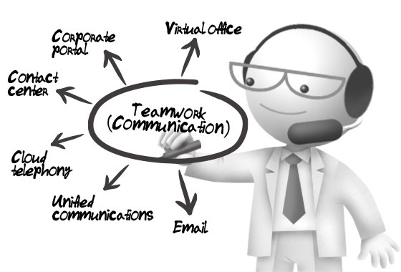



Some of the world’s largest companies and most respected brands in business have adopted this organizational strategy

Slide 6

Key ingredients to set-up a virtual office

Slide 7






Key ingredients to set-up a virtual office
Secure the essential equipment
Stay connected &
organized
Role of VPN in
virtual set-up
Choose the right communication
and collaboration tools
Move your data storage
to the cloud

Slide 8

6 Ways to Improve Work Performance in Your Virtual Office

Slide 9

6 Ways to Improve Work Performance in Your Virtual Office
01
Build personal connection
02
Spark competitiveness
03
Invest in collaboration tools
04
Focus on outcomes
05
Enforce time management policies
06
Role of co-working space digitalizing your practice

Slide 10


Comparison between virtual and Traditional Offices
Virtual Office | Traditional Offices
Cloud server, Cloud based working files, Cloud storage (Azure, AWS, Google drive) and access on cloud connected devices | File cabinet - File sharing, co-working, archival and retrieval management and Physical server, Desktop working files (O365, Google Workspace etc.)
VPN for access to private cloud systems | Physical access controls
Online attendance | Physical attendance
Client collaboration platforms and communication tools such as – Outlook, MS-chat, Google Duo, Zoom etc. for conducting virtual meetings, Video calls and presentations | Physical meetings and discussions – Conference room
Digital meeting notes and usage of recording features (MS – OneNote) | Notepads to ease sharing minutes and remove disconnect in the meeting
Happy hours / Virtual fun activities | In person parties and celebrations
Virtual reviews | Hot reviews
More Equipment – Laptops, Smartphones, Headphones etc. for staying connected | Comparatively less usage of equipment

Slide 11
Virtual Office v/s Traditional Office
Virtual office
Lower cost
Convenience
Traditional office
Higher cost
Less Flexibility
Difficult to attract talent
More flexibility
Employee satisfaction

Slide 12
Tools and technology to Ensure Seamless operation
01
Database management systems Excel, Access, SharePoint etc.
Data analytics tools Teammate analytics, Power BI, Tableau etc.
Workflow management tools Monday.com, Proof hub, JIRA, Asana etc.
Audit software’s CaseWare, IDEA, Mind bridge, On point, Engagement CCH, My Workpapers etc.
Advisory software’s Auditor Board
Tax software’s TurboTax
Electronic signature DocuSign, Zoho sign
Client collaboration tools Inflo, Huddle, Suralink
Operational Timesheet, invoice management, expense management
People PMS and LMS
02
03
04
05
06
07
08
09
10

Slide 13
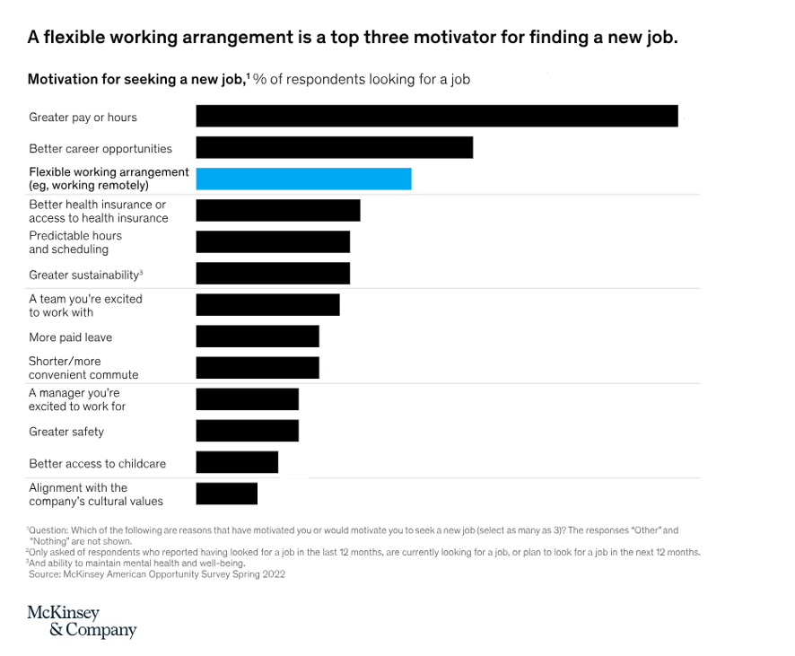
Research
# Job seekers highly value having autonomy over where and when they work
McKinsey research has shown that for those that left the workforce during the early phases of the COVID-19 pandemic, workplace flexibility was a top reason that they accepted new jobs.
Source-https://www.mckinsey.com/industries/real-estate/our-insights/americans-are-embracing-flexible-work-and-they-want-more-of-it#/

Slide 14
Thank you

